Slide 1
IOS Training
IOS basic training plan
Thinh Lai
EMB Dec, 2021

Slide 2
Agenda
Objectives
Materials
Schedule

Slide 3
Objectives
Study, practice and improve IOS programming for experienced engineer.
Writing an IOS application demo

Slide 4
Materials
Swift language: https://docs.swift.org/swift-book/GuidedTour/GuidedTour.html
Books: iOS 14 Programming Beginners 5th
IOS – UIKit tutorials: https://developer.apple.com/tutorials/app-dev-training/#uikit-essentials
Daily report: Wiki: https://jira.hv-vn.com/wiki/display/~thinhhlai.hm/Daily+Report+-+IOS+Training+-+Nhan+Phan
Duration: 4 weeks

Slide 5
Schedule
Lesson 1: Setup environment + Swift programming language
Lesson 2: IOS Fundamentals
Lesson 3: UIKit
Lesson 4: Local Data Persistence
Topic 6: Background Tasks

Slide 6
Schedule
Lesson 5: Network communication
Lesson 6: MVVM architecture & XCTest
Final exercise

Slide 7
Lesson 1: Setup environment + Swift programming language
Content:
Install Xcode
Swift Fundamentals (Variables, Types, Functions, Control Flow, Classes & Structs, Properties, Enums, Closures, Protocols, Collection)
Todo: Complete exercises https://jira.hv-vn.com/wiki/display/~thinhhlai.hm/%5BIOS+Training%5D+Swift+Programming+Exercises#
Duration: 4 days

Slide 8
Lesson 2: IOS Fundamentals
Content:
Application Architecture
Application Lifecycle
View Controller Lifecycle
Xcode basics & Project basics
Cocoapods – dependency manager
Todo:
Accumulate knowledge to do the final exercise.
Duration: 3 days

Slide 9
Lesson 3: UIKit
Content:
UIKit Essentials
Model-View-Controller
Navigation
Table Views and Data Sources & Editable Cells
Modality
Todo:
Build and run the examples in the tutorial
Answer questions
Duration: 3 days

Slide 10
Lesson 4: Local Data Persistence
Content:
NSUserDefaults
Core Data
Todo:
Accumulate knowledge to do the final exercise.
Duration: 2 days

Slide 11
Lesson 5: Network communication
Content:
Network programming - REST API
Alamofire
Todo:
Accumulate knowledge to do the final exercise.
Duration: 2 days

Slide 12
Lesson 6: MVVM architecture & XCTest
Content:
MVVM Architecture
XCTest
Todo:
Accumulate knowledge to do the final exercise.
Duration: 2 days

Slide 13
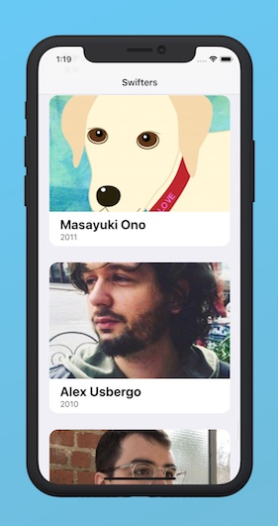
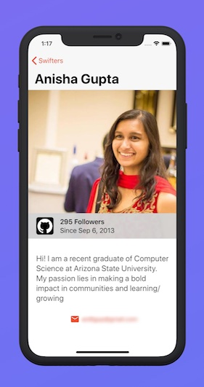
Final exercise:
Exercise requirements:
Screen 1: Load list of user from Github API, can scroll vertically, click on item to open Screen 2, click url to open Browser with the url.
Screen 2: Load user details from Github API with username passed from Screen 1, Click "<" to back Screen 1.
It would be nice to be able to display users in offline mode
Create a repo on Github account to push code for reviewing.
https://api.github.com/users/ono
https://api.github.com/users/usb
Screen 1
Screen 2

Slide 14
Final exercise:
Requirements: MVVM architecture, UIKit, CoreData, Alamofire, working with GIT.
API information:
Get list of user: https://docs.github.com/en/rest/reference/users#list-users
Get user detail: https://docs.github.com/en/rest/reference/users#get-a-user

Slide 15
Thank You

